Slide 1
Introduction to Large Language Models and the Transformer Architecture
Understanding Transformers, LLMs & GPT Model

Slide 2
Introduction to Generative AI
What is GenAI?
GenAI, short for Generative Artificial Intelligence, refers to AI systems capable of generating new content, ideas, or data that mimic human-like creativity. This technology leverages deep learning algorithms to produce outputs ranging from text and images to music and code, based on patterns it learns from vast datasets.
GenAI uses large language models like the Generative Pre-trained Transformer (GPT) and Variational Autoencoders (VAEs) to analyze and understand the structure of the data it’s trained on, enabling the generation of novel content.
What are the key components of GenAI?
Large Language Models (LLMs): Advanced artificial intelligence models trained on vast amounts of textual data to understand, generate, and manipulate human language meaningfully.
Use cases for GenAI in the enterprise
IT and data operations: Create synthetic datasets for training machine learning models, especially when real data is scarce or sensitive. Enhance and clean existing datasets to improve the quality of data analytics.

Slide 3
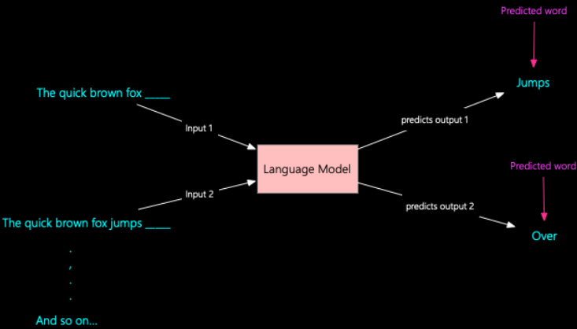
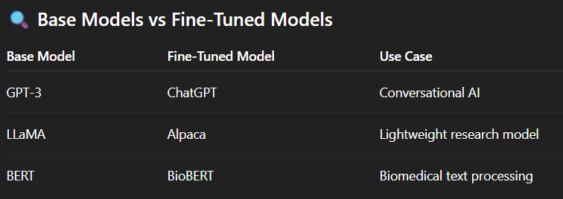
Large Language Models (LLM)
Large Language Models (LLMs) are trained on massive amounts of text data. As a result, they can generate coherent and fluent text. LLMs perform well on various natural languages processing tasks, such as language translation, text summarization, and conversational agents.
Examples: GPT, BERT, PaLM, LLaMA
Figure : LLM Model
The basic premise of a language model is its ability to predict the next word or sub-word (called tokens) based on the text it has observed so far.

Slide 4
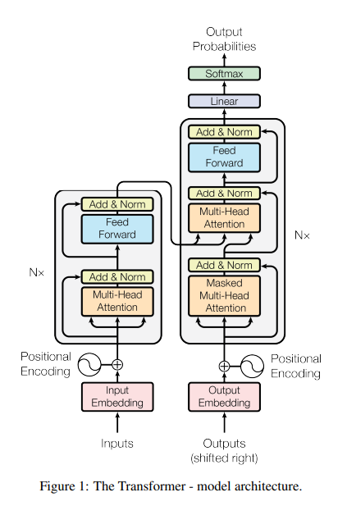
Transformer Architecture Overview
Encoder-Decoder Structure:
The Transformer model is composed of:
Encoder stack: processes the input sequence
Decoder stack: generates the output sequence one token at a time
Encoder Block:
Input Embedding + Positional Encoding
Multi-Head Self-Attention
Add & Norm
Feed Forward Neural Network
Add & Norm
Decoder Block:
Each decoder layer (repeated N times):
Output Embedding + Positional Encoding
Masked Multi-Head Self-Attention
Add & Norm
Multi-Head Attention (Cross Attention)
Add & Norm
Feed Forward Layer
Add & Norm
Final Layers :
Linear + Softmax Layer
Figure : Transformer Architecture

Slide 5
How Transformers Work
Step-by-step processing:
Input embedding + Positional encoding
Input Tokens → Embeddings
Words are converted to vectors using learned embeddings.
Positional encoding is added to retain order information.
Self-Attention Mechanism
Each token attends to every other token in the sequence.
Learns context-aware representations for all positions.
Multi-Head Attention
Runs multiple attention mechanisms in parallel.
Captures different types of relationships between tokens.
Feed-Forward Network
Each position passes through a small neural network.
Same weights are used for every token position.
Residual Connections + Layer Normalization
Helps stabilize training and preserve information.
Decoder (for output generation)
Uses masked self-attention to prevent future token peeking.
Attends over encoder outputs to generate new tokens.
Final Linear + Softmax Layer
Converts decoder output into probabilities over vocabulary.
Highest probability token is selected as the next output.

Slide 6

Attention Mechanism
Scaled Dot-Product Attention
We take the dot product between Q and K to get similarity scores. Divide by √dk (the dimension of keys) to scale down large values and stabilize gradients.
Apply a softmax function to turn these scores into probabilities. Finally, these attention weights are used to produce a weighted combination of the V vectors.
What is Attention?
Mechanism to focus on relevant parts of the input sequence when generating an output.
Inputs: Query (Q), Key (K), Value (V) vectors
Goal: Compute a weighted sum of values (V), where weights come from the similarity of Query to Keys
Formula:
Why Attention?
Captures relationships regardless of distance – Attention allows the model to relate every word to every other word in the sentence, regardless of how far apart they are.
Replaces recurrence with parallelism – Unlike RNNs, which process one token at a time, attention mechanisms allow the model to process all tokens in parallel, speeding up training.
Forms foundation for all Transformer operations

Slide 7
The Concept of Attention Mechanism
The transformer architecture beats out other ones like Recurrent Neural networks (RNNs) or Long short-term memory (LSTMs) for natural language processing. The reason for the superior performance is mainly because of the "attention mechanism" concept that the transformer uses. The attention mechanism lets the model focus on different parts of the input sequence when making each output token.
The RNNs don't bother with an attention mechanism. Instead, they just plow through the input one word at a time. On the other hand, Transformers can handle the whole input simultaneously.
LSTMs use a hidden state to remember what happened in the past. Still, they can struggle to learn when there are too many layers (a.k.a. the vanishing gradient problem).

Slide 8
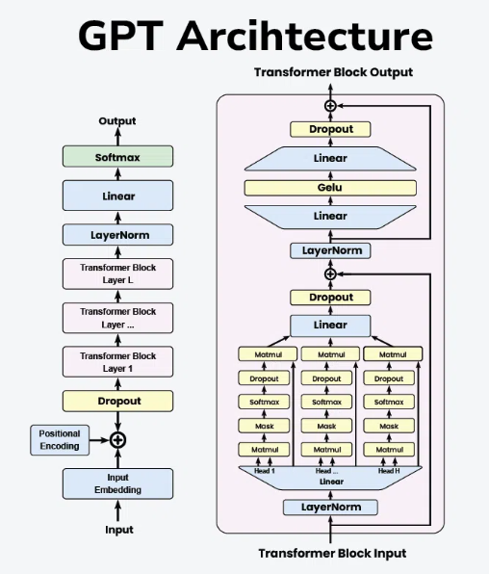
GPT Architecture
Important elements of this architecture consist of:
Self-Attention System
Layer normalization and residual connections
Feedforward Neural Networks
Input Embedding: Converts text tokens into dense vectors
Positional Encoding: Adds order information to embeddings
Dropout Layer: Prevents overfitting
Transformer Blocks (repeated N times):
Layer Normalization:Each transformer block starts with a layer normalization.
Multi-Head Self-Attention: are core component, where the input passes through multiple attention heads.
Residual Connection + Add & Norm: The output of the attention mechanism is added back to the input (residual connection) and normalized again.
Feed-Forward Neural Network (FFN): A position-wise FFN is applied, typically consisting of two linear transformations with a GeLU activation in between.
Dropout: is applied to the feed-forward network output.
Final Layers:
LayerNorm: is final layer normalization is applied. → Linear Layer: The output is passed through a linear layer to map it to the vocabulary size.
→ Softmax: A Softmax:layer is applied to produce the final probabilities for each token in the vocabulary.
Figure : GPT Architecture

Slide 9
Training Process of Generative Pre-trained Transformers
Applications of Generative Pre-Trained Transformers
Advantages of GPT
Large-scale text data corpora are used for unsupervised learning to train GPT algorithms. There are two primary stages to the training:
Pre-training: Also known as language modeling this stage teaches the model to anticipate the word that will come next in a sentence.
Fine-tuning: While GPT models perform well in zero-shot and few-shot learning, fine-tuning is occasionally necessary for particular applications.
The versatility of GPT models allows for a wide range of applications, including but not limited to:
Content Creation: GPT can generate articles, stories and poetry, assisting writers with creative tasks.
Education: GPT models can create personalized tutoring systems, generate educational content and assist with language learning.
Programming: GPT's ability to generate code from natural language descriptions aids developers in software development and debugging.
Scalability: As more data is fed into the model, its ability to understand and generate language improves.
Contextual Understanding: Its deep learning capabilities allow it to understand and generate text with a high degree of relevance and contextuality.

Slide 10
Key Features of Transformer & GPT
Parallelizable
Unlike RNNs, transformers process all tokens simultaneously
Enables faster training on GPUs
Handles Long-Range Dependencies
Self-attention allows any word to relate to any other, regardless of distance
Solves limitations of RNNs which forget earlier context
Scalable Architecture
Add more layers and parameters for higher capacity
GPT models range from millions to hundreds of billions of parameters
Real-World Applications
Conversational AI (e.g. ChatGPT)
Document summarization
Machine translation
Code generation, reasoning, and more

Slide 11
References
The Illustrated Transformer – Jay Alammar
Attention is All you Need
https://www.linkedin.com/pulse/discover-how-chatgpt-istrained-pradeep-menon/
https://www.linkedin.com/pulse/introduction-large-language-models-transformer-pradeep-menon/
https://www.geeksforgeeks.org/artificial-intelligence/introduction-to-generative-pre-trained-transformer-gpt/

